Slide 1
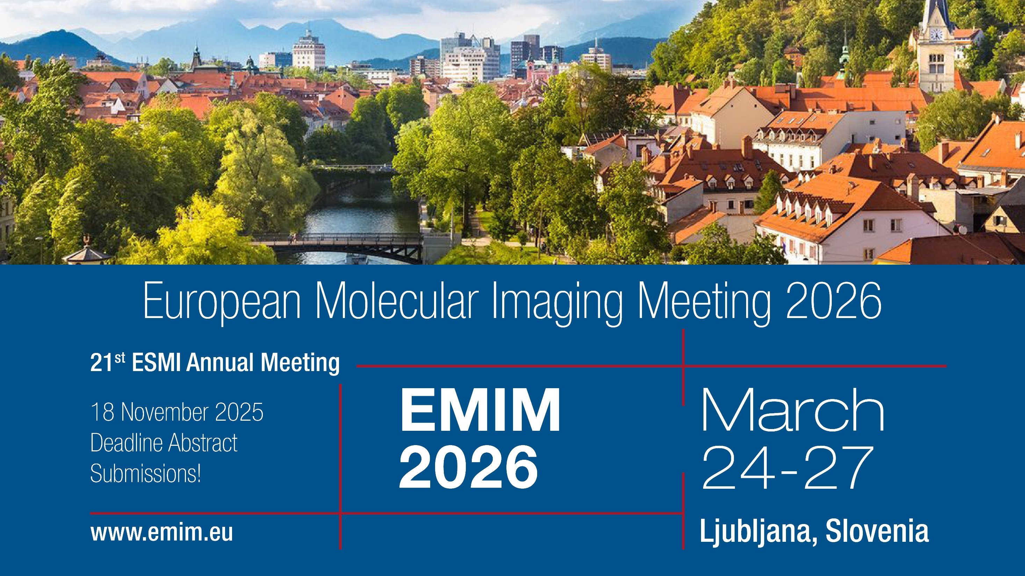

Slide 2
The EMIM in Numbers
What to expect:
Each abstract reviewed by 12+ reviewers
75 oral sessions
350+ talks
500+ posters
800+ reviewers, 10.000+ single review scores
Attracting over 1200 international participants, the EMIM blends world-class science with a collaborative, inclusive atmosphere.

Slide 3

Main Categories
Bringing together all imaging modalities & related disciplines
The number of submissions as presenting author is limited to one (no limit on co-authorship).
The overall number of submissions is limited to the top scored 750.
1 | Physics, Engineering & Technologies
2 | Probe Chemistry & Reporter Genes
3 | Data Processing, Analysis & Modeling
4 | Image-Guided Therapy
5 | Cardiovascular & Respiratory
6 | CNS & Peripheral Nerves
7 | Oncology
8 | Immunology, Inflammation & Infection
9 | In Vitro Models
Submission Deadline
18 November 2025
30 Oral Sessions and two Poster Sessions are reserved for your original, unpublished work!

Slide 4
EMIM 2026
Markita Landry, UC Berkeley
Hans Clevers, Utrecht
Katherine Ferrara, Stanford
Simon Cherry (ESMI Award)
Plenary Speakers
TRAILBLAZER LECTURE!
The Trailblazer Lecture celebrates a scientist whose work has advanced beyond early-career recognition. It shines a light on a rising leader whose trajectory points unmistakably toward lasting impact and excellence at the highest level.

Slide 5
EMIM 2026 | Basic Timeline
30 September
Opening Abstract Submission
18 November
Deadline Abstract Submission
5 January 2026
21 January 2026
Notification to Presenter
Deadline early bird Registration
PRO TIP
Arrange your travel early/now! Flights are not that frequent and can get expensive.
Submission, registration, further information @ www.emim.eu

Slide 6
See you in spring 2026 in Ljubljana!

