Slide 1
The EMIM 2025 | 11-14 March in Bilbao
www.e-smi.eu

Slide 3
Science | EMIM 2025, Bilbao
9 Plenary Talks
4 Educational Sessions
30 Parallel Sessions
5 Focus Sessions
8 Project Sessions
10 Study Group Meetings
1 Certified 3R Symposium

Slide 4
Main Categories | EMIM 2025, Bilbao
Bringing together all imaging modalities & related disciplines
1 | Physics, Engineering & Technologies
2 | Probe Chemistry & Reporter Genes
3 | Reconstruction, Processing, Analysis & Modeling
4 | Image-Guided Therapy
5 | Cardiovascular & Respiratory
6 | CNS & Peripheral Nerves
7 | Musculoskeletal
8 | Gastrointestinal
9 | Oncology
10 | Immunology, Inflammation & Infection
11 | Metabolism
12 | Advanced In Vitro Models
THAT’S NEW!
The number of submissions as presenting author is limited to one (no limit on co-authorship).
The overall number of submissions is limited to the top scored 750.

Slide 5
Programme Building | EMIM 2025, Bilbao
Presidents
150+ subChairs
THE BASIS 800+ Reviewer
26 Category Chairs
Supervision
Determine abstract categories, recommend subChairs, session building
Responsible for set of reviewers per category
Double-blind, min of 12 reviewers per abstract, best/worst excluded

Slide 6
Timeline | EMIM 2025, Bilbao
24 September
19 November
Deadline Abstract Submission
3 January 2025
16 January 2025
Notification to Presenter
Deadline early bird Registration
Opening Abstract Submission

Slide 7
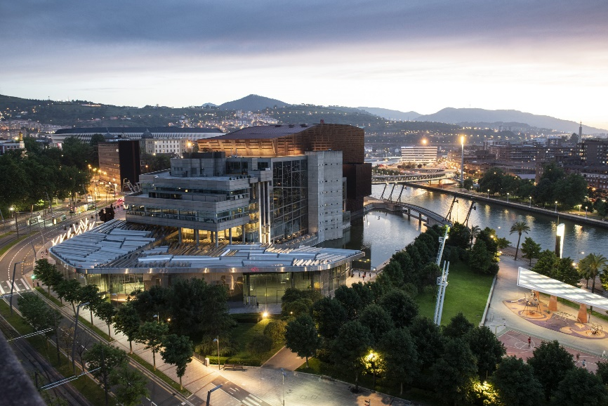
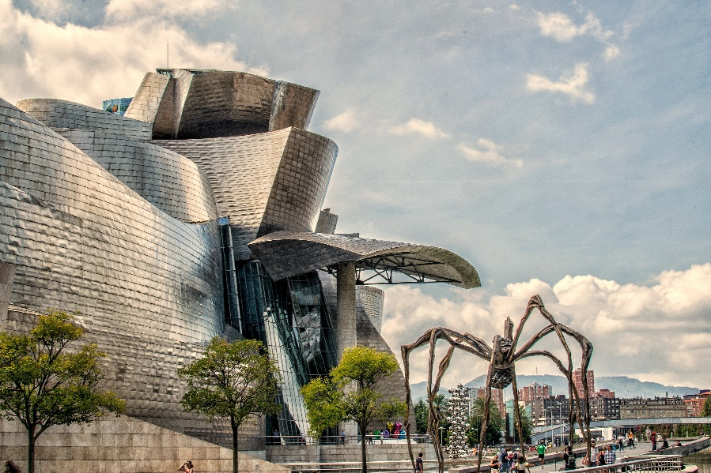
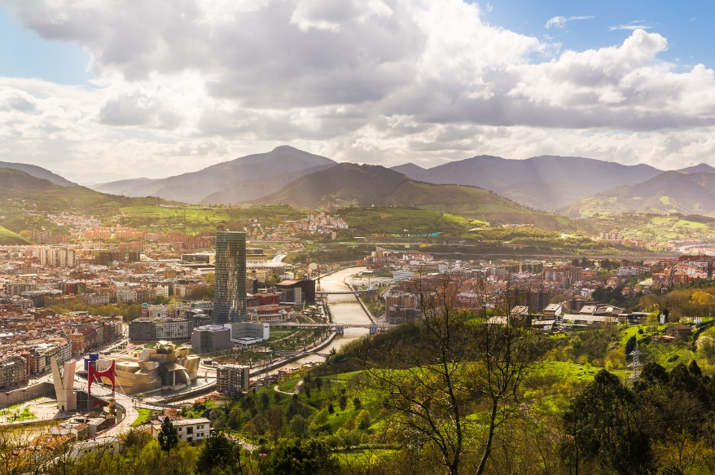
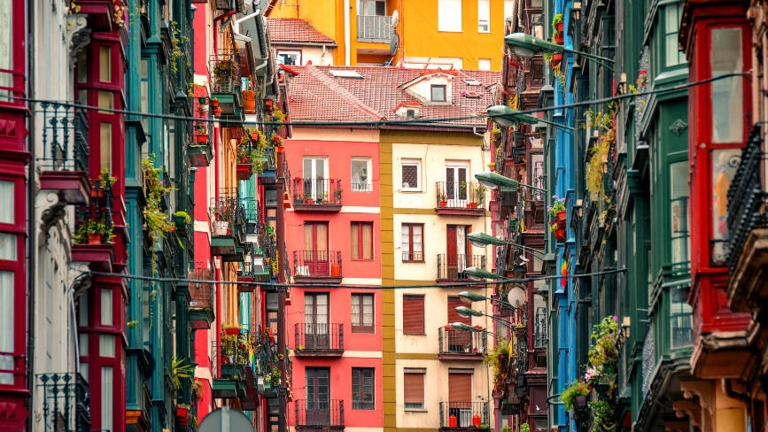
See you @ the EMIM 2025 in Bilbao
It is your Society &
the Home for your Research!
11-14 March | www.emim.eu
With 1200 international participants, the EMIM has significantly grown while preserving its collaborative, inclusive, and lively atmosphere.
It is packed with excellent science and serves as comprehensive and inspiring platform for multidisciplinary exchange and collaboration in this broad and wonderful field of imaging science.
Congress Center
Guggenheim Museum with „Maman“
Bilbao Surroundings
Old Town

