Slide 1

The EMIM 2024 | 12-15 March in Porto
www.e-smi.eu

Slide 2
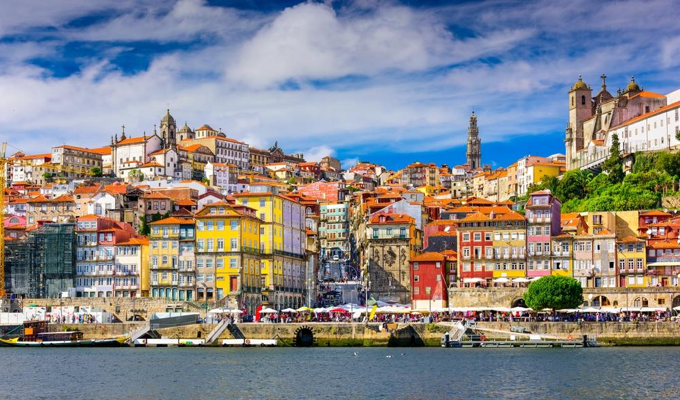

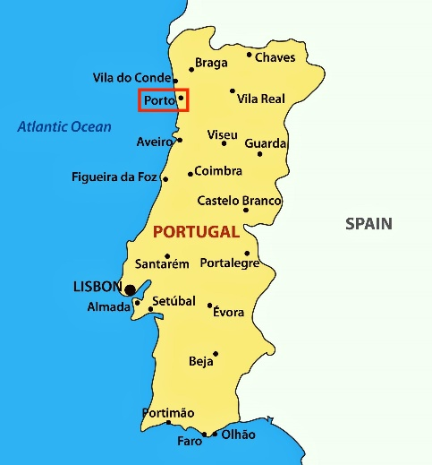
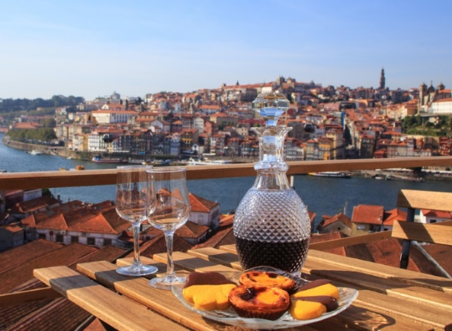
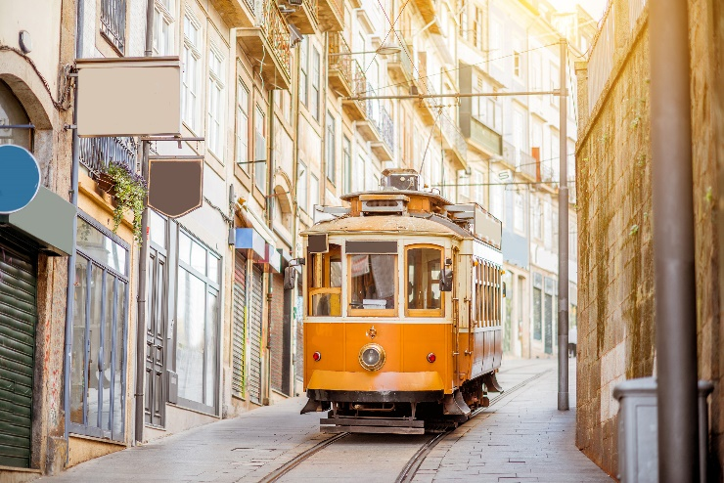
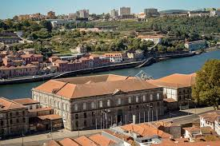
See you @ the EMIM 2024 | Porto
It is your Society &
the Home for your Research!
12-15 March | www.emim.eu
1000+ international participants
750 talks & poster presentations
Focus on scientific excellence
Collaborative & Welcoming

Slide 3
Science | EMIM 2024, Porto
9 Plenary Talks
4 Educational Sessions
30 Parallel Sessions
5 Focus Sessions
8 Project Sessions
10 Study Group Meetings
1 Certified 3R Symposium

Slide 4
Main Categories @ EMIM 2024
ID | Main Category
1 | Physics, Engineering & Technologies
2 | Probe Chemistry & Reporter Genes
3 | Reconstruction, Processing & Analysis
4 | Image-Guided Therapy
5 | Cardiovascular & Respiratory
6 | CNS & Peripheral Nerves
7 | Musculoskeletal
8 | Gastrointestinal
9 | Oncology
10 | Immunology, Inflammation & Infection
11 | Metabolism
12 | Advanced In Vitro Models & Developmental Biology

Slide 5
Programme Building
Presidents
150+
subChairs
THE BASIS
700+ Reviewer
28
Category Chairs
Supervision
Determine abstract categories, recommend subChairs,
session building
Responsible for set of reviewers per category
Double-blind, min of 12 reviewers per abstract, best/worst excluded

Slide 6
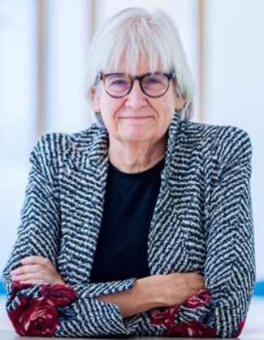

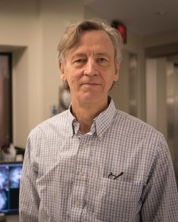
Plenary Speakers @ EMIM 2024
ELISABETH DE VRIES – ESMI Award Recipient 2024
Elisabeth is recognised for her pioneering work in translating novel radionuclide- and fluorescence-based imaging agents to detect cancer and its response to treatment.
She is Professor of Medical Oncology at the University Medical
Centre Groningen
KULLERVO HYNYNEN
“MRI-Guided Focused Ultrasound“
Vice-President, Research and Innovation, Director Focused
Ultrasound group at Sunnybrook Research Institute in Toronto

Slide 7
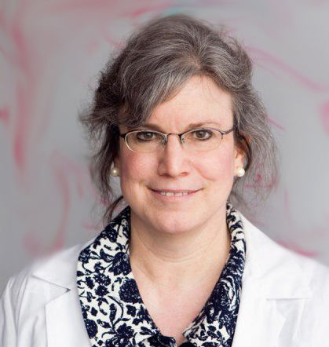
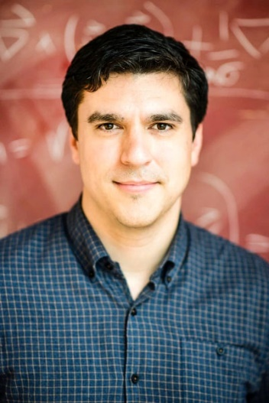
Plenary Speakers @ EMIM 2024
MICHELLE BRADBURY
“New Frontiers and Emerging Nanomaterials for Advancing Image-Guided Perioperative Cancer Care and Drug Delivery”
Director, Molecular Imaging Institute & Perioperative Imaging & Engineered Technologies for Oncology at Cornell Institute for Engineering Innovations in Medicine in New York
JOSEPH MORAN
“The Metabolic Origin of Life”
Director Laboratory of Chemical Catalysis at the University of Strasbourg

Slide 8

Deadlines | EMIM 2024
BASIC DEADLINES
10 October | Opening Abstract Submission
21 November | Deadline Abstract Submission
4 January 2024 | Notification to Presenters
17 January | Deadline Early Registration
Mark your calendar, prepare your submissions, inform your colleagues, and simply enjoy planning for a wonderful EMIM
in Porto next spring.
www.emim.eu

